Slide 1
Semester Update (PhD research update, my research orientation)
Advisor: Venkatesh Choppella, PhD
Sai Gollapudi
Fall, 2014

Slide 2
Imagine…
Cartoon
Website explaining something…

Slide 3
Thank god. I am saved!

Slide 4
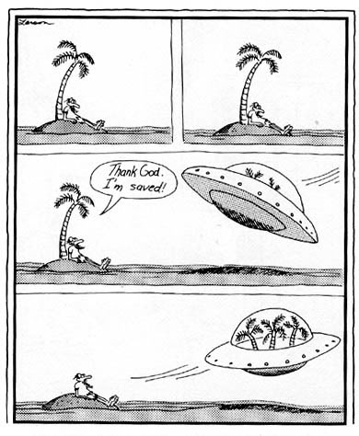
Notes:
http://i461.photobucket.com/albums/qq334/ladez12/FarSide.jpg

Slide 5
Notes:
http://i461.photobucket.com/albums/qq334/ladez12/FarSide.jpg

Slide 6
Application Space
Web Accessibility / Visual renarration
Help visually challenged people gain access to informative visual content
Research goal:
Framework to aid visually challenged users get access to structured visual content
Current systems are inadequate, incomplete
Tactile
Sonification
<Alt-text>

Slide 7
My aspiration (Solution Space)
Using cognitive science principles and current computer science techniques and technologies, I wish to come up with an approach & framework to address this accessibility problem
Solution can be of use to sighted users also in situational blindness cases… or in better understanding representation / manipulation of diagrams

Slide 8
Problem space
Soln space
Theory Space
CSE approach
LS: current soln, grammar
Reaffirm hypothesis
translators
Tool chains
LS: CogSci theory
ProgLang
formalism
Concept of grammars
intermodal
LS: CSE approach
VisLang
CogSci theory
Surface
Interactivity
Info forage
ontologies
LS: how ontology
Dialog system
LS: current dialog system
Reaffirm hypothesis
Surface, validation
Application Instance
My Approach
Build, validation
LS: inadequate, incomplete
Blind people
!access visual content
Framework using ontologies, dialog systems to do inter modal xlations to solve blind access problem

Slide 9
My proposed (primary) contributions
(Developing) an Approach that uses existing CSE components to address CogSci inter-modality and interactivity problem
CSE components utilize: formalism, grammar, ontologies, translation systems etc.
(Developing) a Framework that uses above approach for providing visual accessibility
Provides the social value of blind-user accessibility
Also an alternate approach for sighted-users

Slide 10
My work this semester
Exploring & crystalizing my problem
Articulating my approach
Clarity
Beginning my literature surveys
Confidence
Targeting publications (W4A) – but which experiment?
Credibility

Slide 11
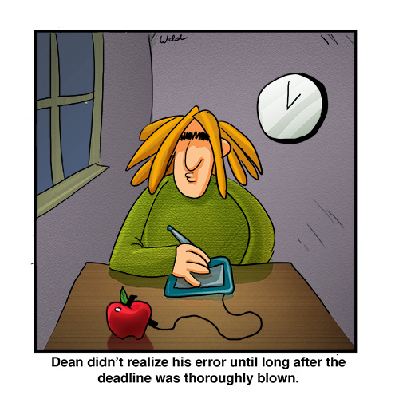
Notes:
http://bhughey.commons.hwdsb.on.ca/files/2013/04/Apple.jpg

Slide 12
My Findings…

Slide 13
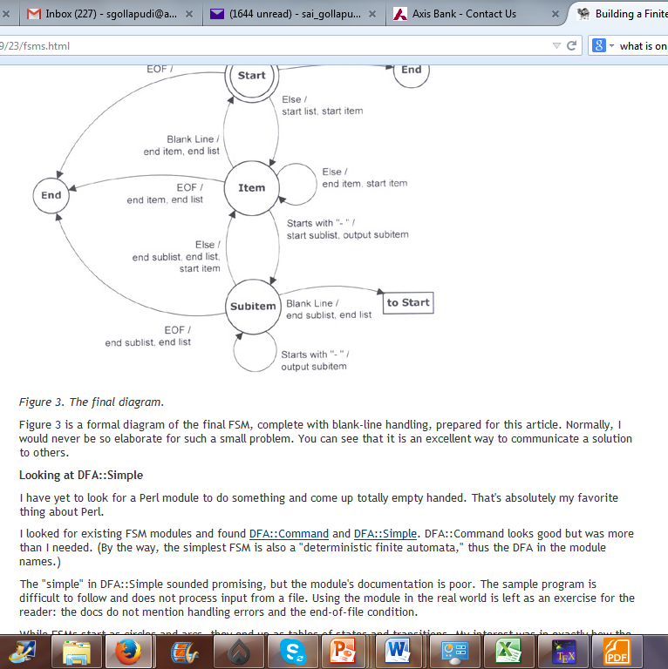

Figure may be presented as brief narrative (given
by the <alt text> tag)
Text can be presented as input to either a Braille or to a text-to-speech system
Raw online illustrated input
Current options only address the text portion
Output is provided as text only
Notes:
http://www.perl.com/pub/2004/09/23/fsms.html

Slide 14
CogSci
Gaze, Scanpath, Visual Exploration, info foraging
Partial Hypothesis, observation, validation, improved hypothesis
Interactivity
Brain + Perceptual systems
Will functions of organ X be replaced by Y in disabled cases? Will the same intent / tendencies of the brain (or neural processes) persist even in the new organ? How does it impact modal translations?
Inter Modal + Translations

Slide 15

online illustrated input
Our system processes
the text + diagram
Dialog system to interact with visuals. Plus normal text as inputs to UI
Text based
interaction
Dialog
System
UI for visually challenged user integrates text-to-speech
Text
Proposed new work
Notes:
http://www.perl.com/pub/2004/09/23/fsms.html
http://www.sigmabooks.co.uk/_borders/logo.jpg

Slide 16
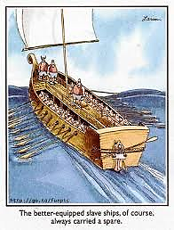
The better equipped slave ships, of course,
always carried a spare.
Notes:
http://mydl.itweb.co.za/index.php?view=image&format=raw&type=img&id=664&option=com_joomgallery&Itemid=335

Slide 17
picture
description
unstructured
accessibility
restricted
cartoon
description
Semi-structured
accessibility
restricted
EngDiagrams
semantics
Well-structured
accessibility
bizProcDiagrams
semantics
Well-structured
accessibility

Slide 18
Math symbols
Photographs
Diagrams
Cartoons
Artwork
Notation
Comics
Text
MORE Structure
LESS Structure
Grammar orientation
Convention orientation
Connected Diagrams
BPMN, UML, discipline oriented diagrams…
Scientific Diagrams
Technical Drawings

Slide 19

Renarrate only partial categories to enable better accessibility of illustrated content
Tons of Illustrated content
Framework for Structuring & accessing Visual content
Comprehension requires
Understanding of both modes
Graphics, a big challenge for blind
Editing tools
Dialog system
Prototype will be built
Validated with blind users
Text
more
Discipline + Genre linked ONTOLOGIES
Text to speech tools integrated UI
Graphics
Online storage
structure
SWeets
less

Slide 20
Image
Raw Input
Store in some Internal notation
Interact with internal notation
Presentation to visually challenged user
Trans-cription
Semantic abstraction
Semantic Search
Multimodal Presentation
Techniques:
Orig Author AltText
Volunteer User Renarration
Crowd sourced Img annotation
Computer mediated Image Processing
Using CAD techn
(custom editor)
Techniques:
Existing notations: XPDL, DOT
Proprietary grammar
Ontologies design, use & validation
Techniques:
Query engine
Stored vs real-time eval
Dialogue systems
Techniques:
Text
Text + audio
Multi-track audio
Grammar for sound effects track

Slide 21
Text to speech convertor
UI
Natural language Text to Query lang translator
Ontology4 for text queries
Query Engine
Dialog system
Ontology3 for queries
Semantic model
Ontology2 for representation
Internal
model
Descriptive model
Ontology1 for representation
XPDL

Slide 22
Next Steps
W4A <- experiments
TACCESS <- clarity in story + significant research findings

Slide 23
Theory Space
Problem Space
Solution Space
Theories
Theoretical Abstraction of prob space
CSE/SE
Principles & practices
Application Space
Practical life challenge
Solution to the practical life problem

Slide 24
Lit survey (major)
Lit survey (minor)
How CSE/SE
Addressed S&V
DP, Ont, PL
Surface S&V
My contribution
Lit survey (minor)
My Approach
My research
ET
Used SE principles to solve my problem
AL

